Slide 1
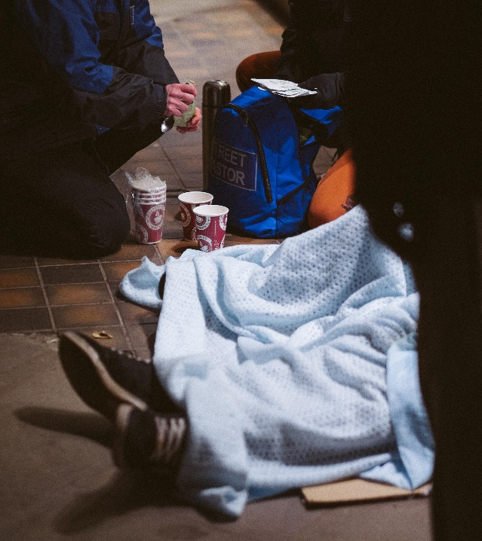
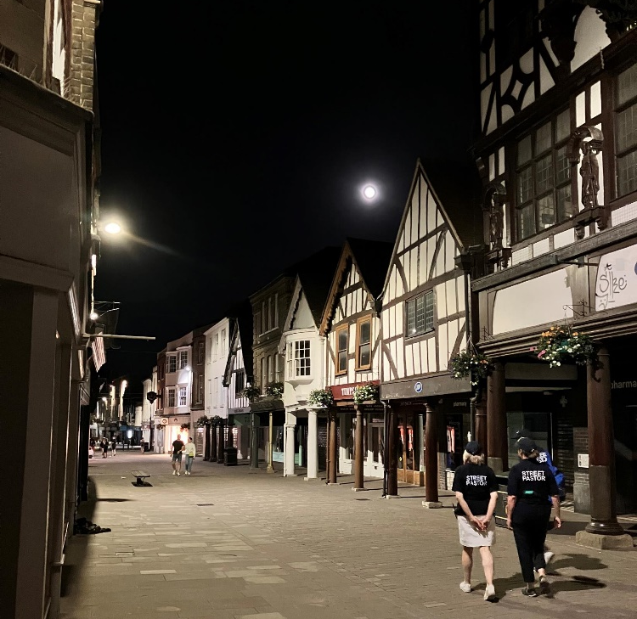
Winchester Street Pastors Update September 2022 Out there until late each weekend!

Slide 2
Winchester Street Pastors Update
Out each Friday and Saturday evening between 10pm and around 2am - OFFERING REASSURANCE, SAFETY AND SUPPORT, BY CARING, LISTENING AND HELPING
Each team backed by 2 Prayer Pastors (from base)
One patrol per month for each volunteer
Ever thought about joining us? Come out as an observer one evening!

Slide 3
Winchester Street Pastors Update - September 2022
Join us as an ‘OBSERVER’ for the evening & see if it’s for you
Join as a…
Street Pastor – Early or Late team
Pray at home
How can YOU help WSPs?
Join ‘1in100’ & give £10/month
Join as a…
Prayer Pastor – Early or Late team

Slide 4
Winchester Street Pastors Update - September 2022
Recruiting Street Pastors NOW, for training in October & November
Urgently seeking PRAYER Pastors NOW – we need NINE to make up our teams
Watch our video on YouTube: search Knights of Winchester
For more information or to join us as an observer one evening contact
Mark Hibbbert-Hingston on
winchester@streetpastors.org.uk or 07740 288654
Website: https://streetpastors.org/locations/winchester
Follow us on

